Slide 1
Unit 6

Slide 2
Unit 6: Application of statistics
Demographic study source of demographic data, Age- sex composition, measurement of mortality and life tables, measurement of fertility, economic study index number, time series analysis, statistical quality control, Nepalese official statistics and national income (only concept and illustration of few examples) ( 8 hrs)

Slide 3
Masculinity Proportion (Sex Ratio)
Masculinity Proportion (Sex ratio)=Number of Male*100/Number of Female
Sex Ratio of Births= Number of Male birth*100/Number of Female birth
Sex Ratio of Deaths= Number of Male death*100/Number of Female death

Slide 4
Sex Ratio of Migrants= Number of Male migrants*100/Number of Female migrants

Slide 5
Calculate the masculinity proportion from given data set
Vilage | M popupation in 2020 | FM popupation in 2020 | Male birth in 2021 | Female Birt in 2021h | Male Imigration in 2021 | FMale Imigration in 2021 | Male Emigratio in 2021 | FMale Emigrati in 2021 | Total Mpop 2021 | Total Fmpop 2021
A | 121 | 143 | 11 | 15 | 11 | 17 | 10 | 7 | 133 | 168
B | 123 | 125 | 14 | 17 | 10 | 12 | 9 | 7 | 138 | 147
C | 143 | 146 | 15 | 19 | 9 | 14 | 8 | 4 | 159 | 175
 | 387 | 414 | 40 | 51 | 30 | 43 | 27 | 18 | 430 | 490
 |  |  |  |  |  |  |  | Masculinity ratio | 87.7551

Slide 6
Age
P₀₋₁₄ = Proportion of children under 15
P₆₅₊ = Proportion of aged persons
P₁₅₋₆₄ = Proportion of persons of “working age”
Age-Dependency Ratios—Proportion of children less than 15 and elderly 65+ relative to the population of “working ages”
Age-Dependency Ratios= (P₀₋₁₄ + P₆₅₊ )*100/ P₁₅₋₆₄

Slide 7
Child-Dependency Ratio—Proportion of children less than 15 relative to the population of “working ages”
Child-Dependency Ratio= (P₀₋₁₄ )*100/ P₁₅₋₆₄
Old-Age Dependency Ratio—Proportion of adults over age 65 relative to the population of “working ages”
Old-Age Dependency Ratio= (P₆₅₊ )*100/ P₁₅₋₆₄

Slide 8
Age Pyramid
Age Pyramid  Gives a detailed picture of the age-sex structure of a population  Consists of bars representing age groups in ascending order from lowest to highest pyramided on one another  Bars are generally by single or 5-year age groups
Number (or percentage) of persons in an age group is indicated by length of its bar from central axis  Males on left side; females on right side  Pyramids with absolute numbers show differences in overall sizes of total populations and in number at each age  Percent pyramids show relative differences in population size at each age-sex group

Slide 9
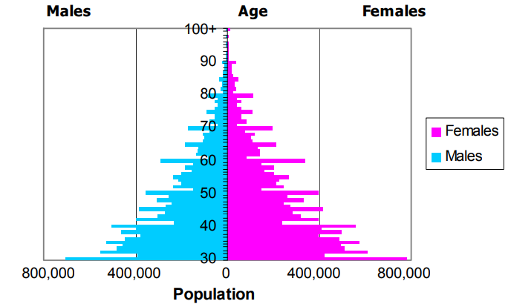
Age pyramid

Slide 10
The ASFR is calculated as
The Age-Specific Fertility Rate (ASFR) is the number of live births per 1000 women in a specific age group for a specified geographic area and for a specific point in time, usually a calendar year.

Slide 11
ASFR_{a} = (B_{a}/E_{a}) x1000
Where:
B_{a} = number of births to women in age group a in a given year or reference period; and
E_{a} = number of person-years of exposure in age group a during the specified reference period.
Calculate rate if fertility of women
Age Group (1) | Births (B_{a}) (2) | Person- Years of Exposure (E_{a}) (3) | Rate/Woman (4)= 2/3 | Rate/1000 person years (5)=2*1000/3
15-19 | 764 | 14893.2 | 0.051 | 51
20-24 | 2304 | 11747.2 | 0.196 | 196
25-29 | 1994 | 9602.3 | 0.208 | 208
30-34 | 1295 | 8805.5 | 0.147 | 147
35-39 | 564 | 7549.5 | 0.075 | 75
40-44 | 161 | 6643.2 | 0.024 | 24
45-49 | 19 | 4498.8 | 0.004 | 4

Slide 12
A life table is a record of survival and reproductive rates in a population, broken down by age, size, or developmental stage.
Life tables are useful in predicting the growth and decline of populations.
For example: The human population of a region depends in part on how many children each person has and the age at which people die.
Perhaps surprisingly, it also depends on the age at which they have their children.

Slide 13
Measurement of fertility
The Total Fertility Rate (TFR) is
the average number of children that would be born alive to a woman during her lifetime if she were to pass through her childbearing years having births according to the current schedule of age-specific fertility rates.

Slide 14
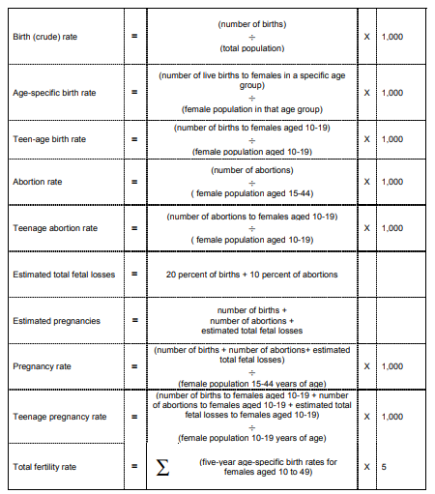

Slide 15
Economic study index number
Index numbers are important in economic statistics.
In simple terms, an index (or index number) is a number displaying the level of a variable relative to its level (set equal to 100) in a given base period.
Index numbers are intended to study the change in the effects of such factors which cannot be measured directly.

Slide 16
Time series analysis
Nonparametric tests such as the Mann-Kendall test for trend are suitable for analyzing data that do not follow a normal distribution.
The Mann-Kendall test for trend is a nonparametric test which has no distributional assumptions and irregularly spaced measurement periods are permitted.
The advantage gained by this approach involves the cases where outliers in the data would produce biased estimates of the least squares estimated slope.

Slide 17
The Mann-Kendall statistic (S) measures the trend in the data. Positive values indicate an increase in constituent concentrations over time, whereas negative values indicate a decrease in constituent concentrations over time. The strength of the trend is proportional to the magnitude of the Mann-Kendall Statistic (i.e., large magnitudes indicate a strong trend).
Mann-Kendall Statistic | Confidence in Trend | Concentration Trend
S > 0 S > 0 S > 0 S ≤ 0 S ≤ 0 S < 0 S < 0 | > 95% 90 - 95% < 90% < 90% and COV ≥ 1 < 90% and COV < 1 90 - 95% 95% | Increasing Probably Increasing No Trend No Trend Stable Probably Decreasing Decreasing

Slide 18
Statistical quality control
Statistical quality control refers to the use of statistical methods in the monitoring and maintaining of the quality of products and services.
One method, referred to as acceptance sampling, can be used when a decision must be made to accept or reject a group of parts or items based on the quality found in a sample.

Slide 19
Statistical quality control (SQC) is the term used to describe the set of statistical tools used by quality professionals. Statistical quality control can be divided into three broad categories:
1. Descriptive statistics are used to describe quality characteristics and relationships. Included are statistics such as the mean, standard deviation, the range, and a measure of the distribution of data.
3. Acceptance sampling is the process of randomly inspecting a sample of goods and deciding whether to accept the entire lot based on the results. Acceptance sampling determines whether a batch of goods should be accepted or rejected.
2. Statistical process control (SPC) involves inspecting a random sample of the output from a process and deciding whether the process is producing products with characteristics that fall within a predetermined range. SPC answers the question of whether the process is functioning properly or not.

Slide 20
Nepali official statistics and national income
epal GDP | Last | Previous | Highest | Lowest | Unit | Status
GDP Annual Growth Rate | 6.30 | 7.90 | 8.60 | 0.10 | percent | [+]
GDP | 24.47 | 21.13 | 24.47 | 0.50 | USD Billion | [+]
GDP per capita | 728.40 | 685.10 | 728.40 | 267.10 | USD | [+]
GDP per capita PPP | 2442.80 | 2297.70 | 2442.80 | 1197.90 | USD | [+]
Gross Fixed Capital Formation | 271870.00 | 234961.00 | 271870.00 | 84751.00 | NPR Million | [+]
GDP Constant Prices | 881798.30 | 829617.30 | 881798.30 | 442048.99 | Million Rupees | [+]
GDP From Agriculture | 254673.10 | 247931.00 | 254673.10 | 158416.88 | NPR Million | [+]
GDP From Construction | 50878.40 | 45987.40 | 50878.40 | 27225.05 | NPR Million | [+]
GDP From Manufacturing | 52408.00 | 48510.00 | 52408.00 | 36364.03 | NPR Million | [+]
GDP From Mining | 3949.00 | 3575.00 | 3949.00 | 1976.74 | NPR Million | [+]
GDP From Public Administration | 16560.00 | 15113.00 | 16560.00 | 7236.53 | NPR Million | [+]
GDP From Services | 112493.00 | 103152.00 | 112493.00 | 61837.00 | NPR Million | [+]
GDP From Transport | 85785.00 | 81384.00 | 85785.00 | 34055.00 | NPR Million | [+]
GDP From Utilities | 18070.00 | 17075.00 | 18070.00 | 8630.85 | NPR Million | [+]
Nepal's per capita income is estimated to have crossed 1,000 U.S. dollar mark for the first time, a major boost for the country in 2017.

Slide 21
THANKS TOO MUCH

